Slide 1

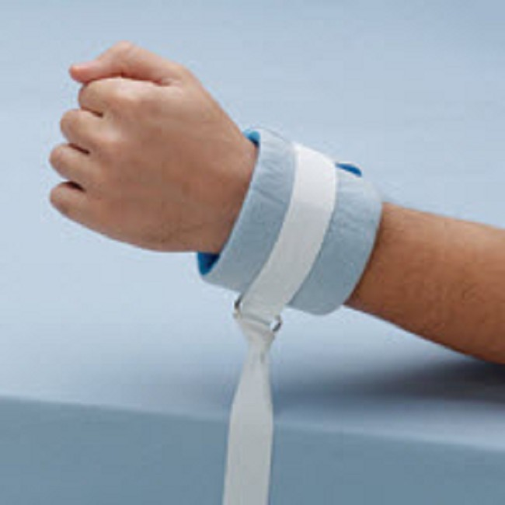
Restraints

Slide 2
Restraints
Who Can be Restrained?
  Patients that may be at risk for harming themselves or others.
    For example, patients may be pulling at or compromising important tubes, lines, and other treatments.
    The patients is being combative with staff.
Why would we need to restrain a patient?
  To ensure the physical safety of the patient, a staff member, or others.
  To promote healing and prevent harm.

Slide 3
restraints
When should a patient be restrained?
  The use of restraint/seclusion is a last resort, after alternative interventions have either been considered or attempted.
    Re-orientation
    De-escalation
    Increased observation and monitoring
    Use of a sitter
    Review and modification of medication regimens
    Repositioning, Use of cushions/pads
    Exercise
    Verbal interventions
    Bed alarm system
  The patient is reassessed often so that we can discontinue the restraints as soon as possible, as this is our goal.

Slide 4
Restraints
What kind of restraints do we normally use?
  Soft fabric wrist/ankle restraints
  vest restraints
What is not considered a restraint?
  if a patient can easily remove a device, the device would not be considered a restraint.
  A restraint does not include devices such as:
    orthopedic prescribed devices
    surgical dressings
    Bandages
    protective helmets
    methods that involve the physical holding of a patient for the purpose of conducting routine physical examinations or tests

Slide 5

Restraints
How can you help a patient that is restrained and may be in distress?
  If you enter a patient room, and you notice the patient "does not look right”, and the restraint may have the potential to harm the patient (Change in skin color, temperature, sensation, appearance)
    1. Immediately release the restraint
    2. Call for help
    3. Try to calm the patient if possible

Slide 6
Ordering requirements for restraints or seclusion
This policy requires that a physician or other licensed independent practitioner (LIP) responsible for the care of the patient order restraint or seclusion prior to the application of restraint or seclusion.
In an emergent situation, the Nurse can apply the restraint, but the order must be obtained either during the emergency application of the restraint or seclusion or immediately afterwards (within a few minutes).
If restraint or seclusion is discontinued prior to the expiration of the original order, a new order must be obtained prior to reinitiating the use of restraint or seclusion.
Restraints are never to be used as a standing order or as a needed basis.

Slide 7
Continued
Violent restraints
  initial orders are valid for the following time frame (provider face to face within 1hr):
    18 and up- 4 hours
    9-17 years old- 2 hours
    Under 9- 1 hour
  Violent renewal orders can be placed up to 24 hours.
  If the violent episode will continue after 24 hours, a NEW order and a provider face to face must be done within 1 hour.
Non-violent restraints
  The initial order is valid for 72 hours
  If the patient remains in restraint for more than 72 hours, then a renewal order must be obtained.
    Renewal order is valid for 72 hours

Slide 8
Further Requirements for ordering restraints AND DOCUMENTATION- see Policy-MCH-2053

Slide 9
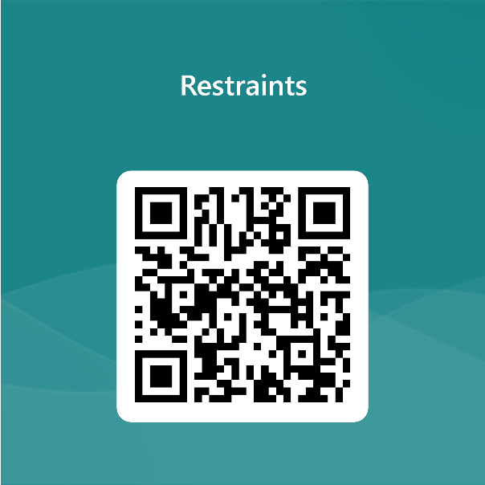
Continue to Test
Link
QR Code
https://forms.office.com/r/hp6Zv4E4gb

